Slide 1
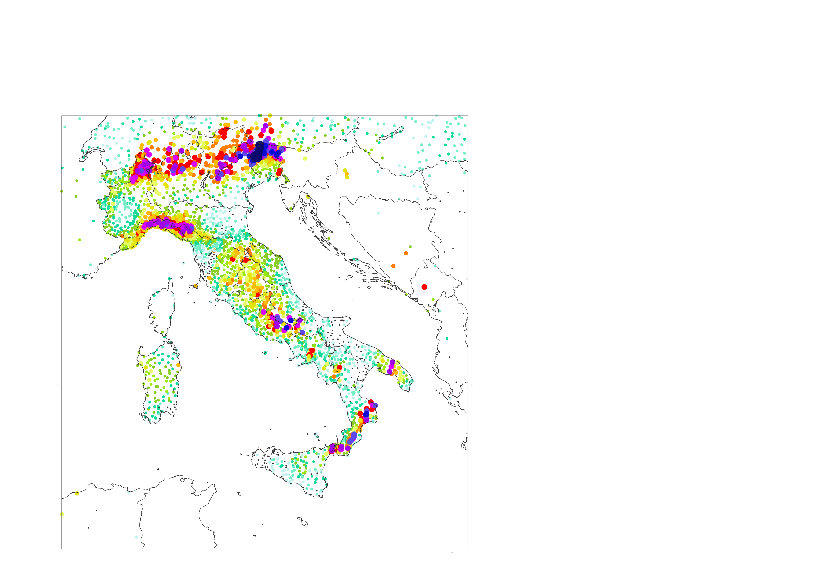
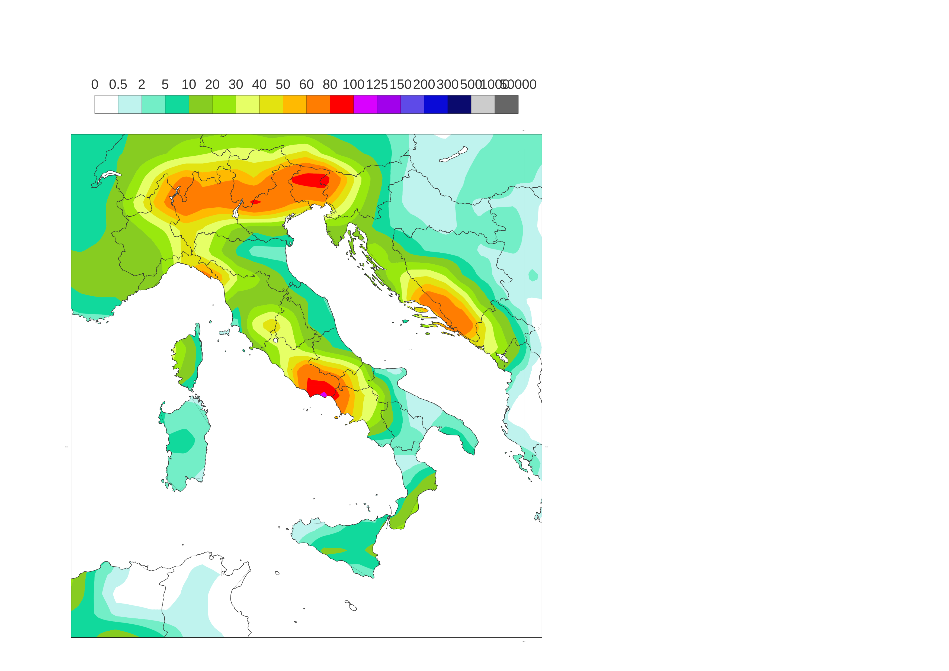
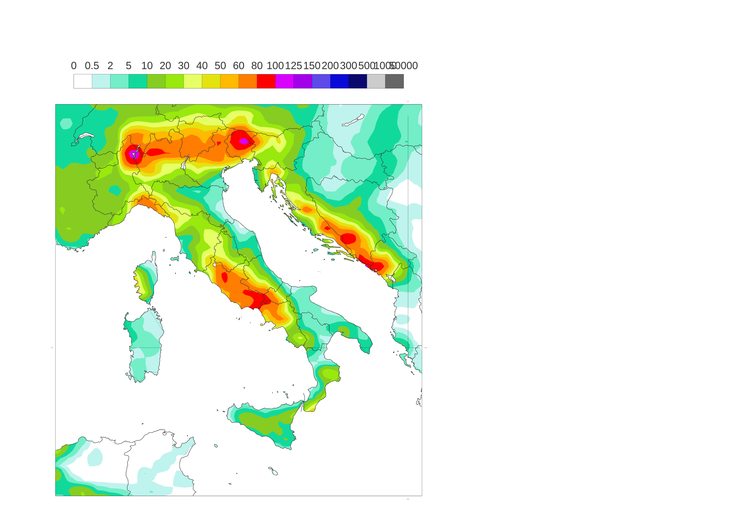
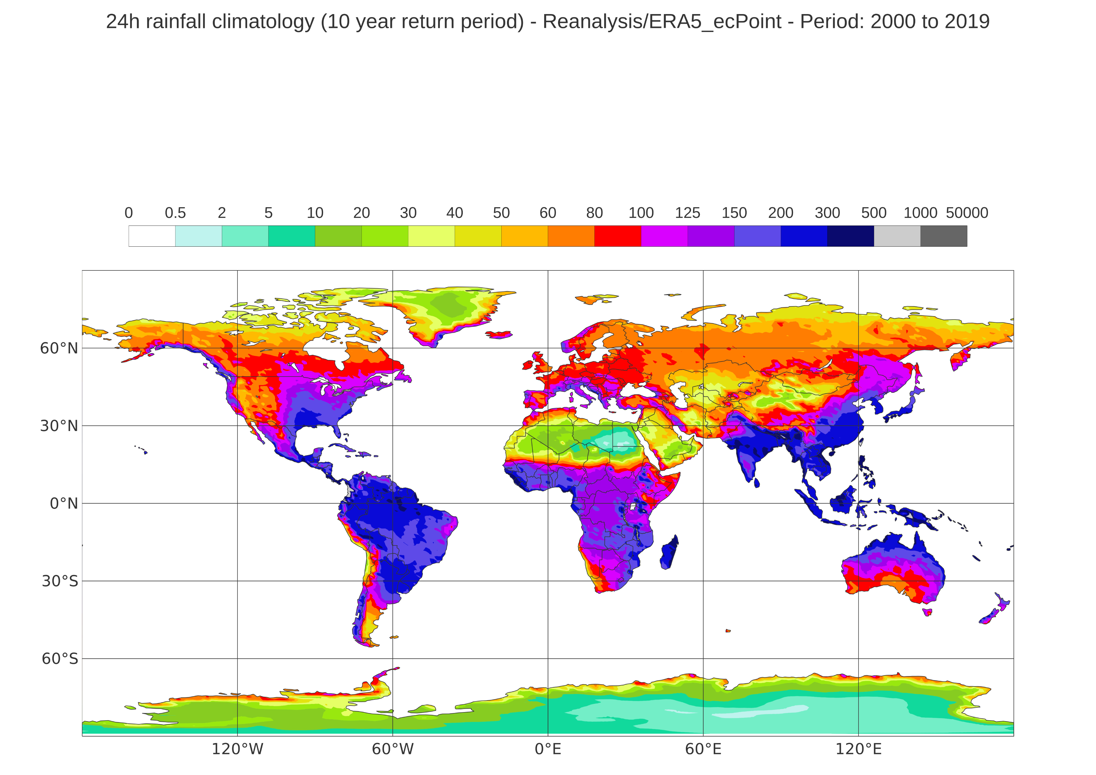
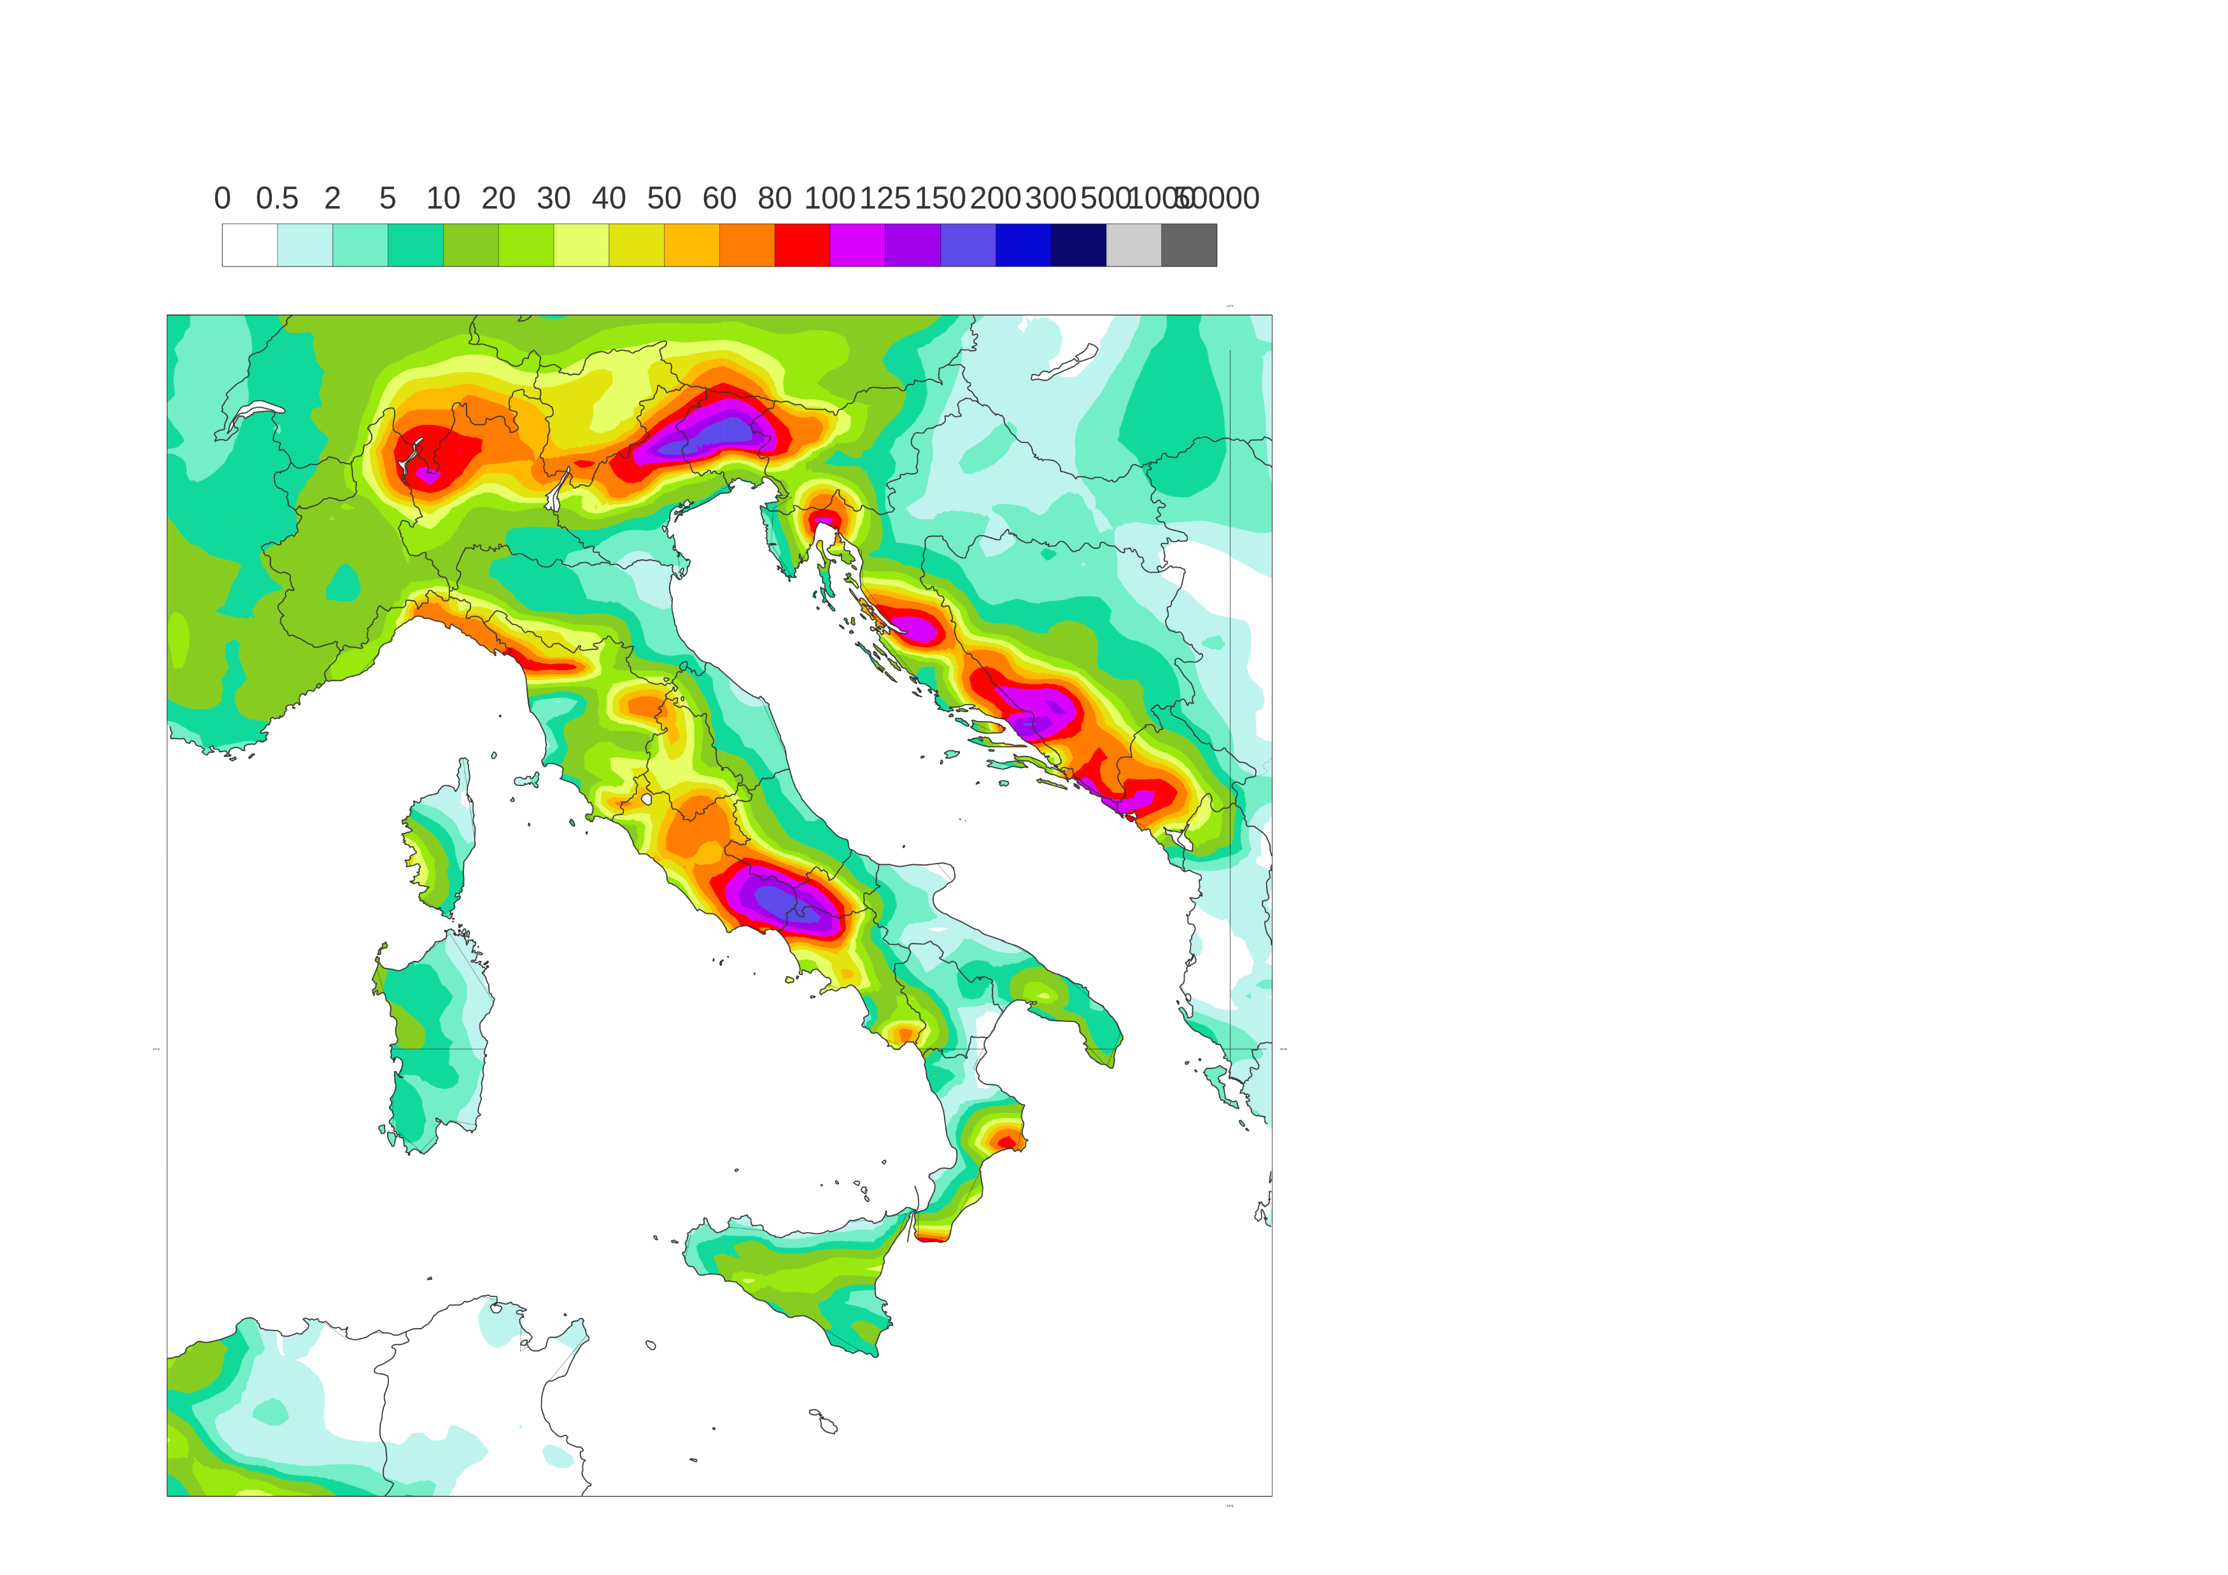
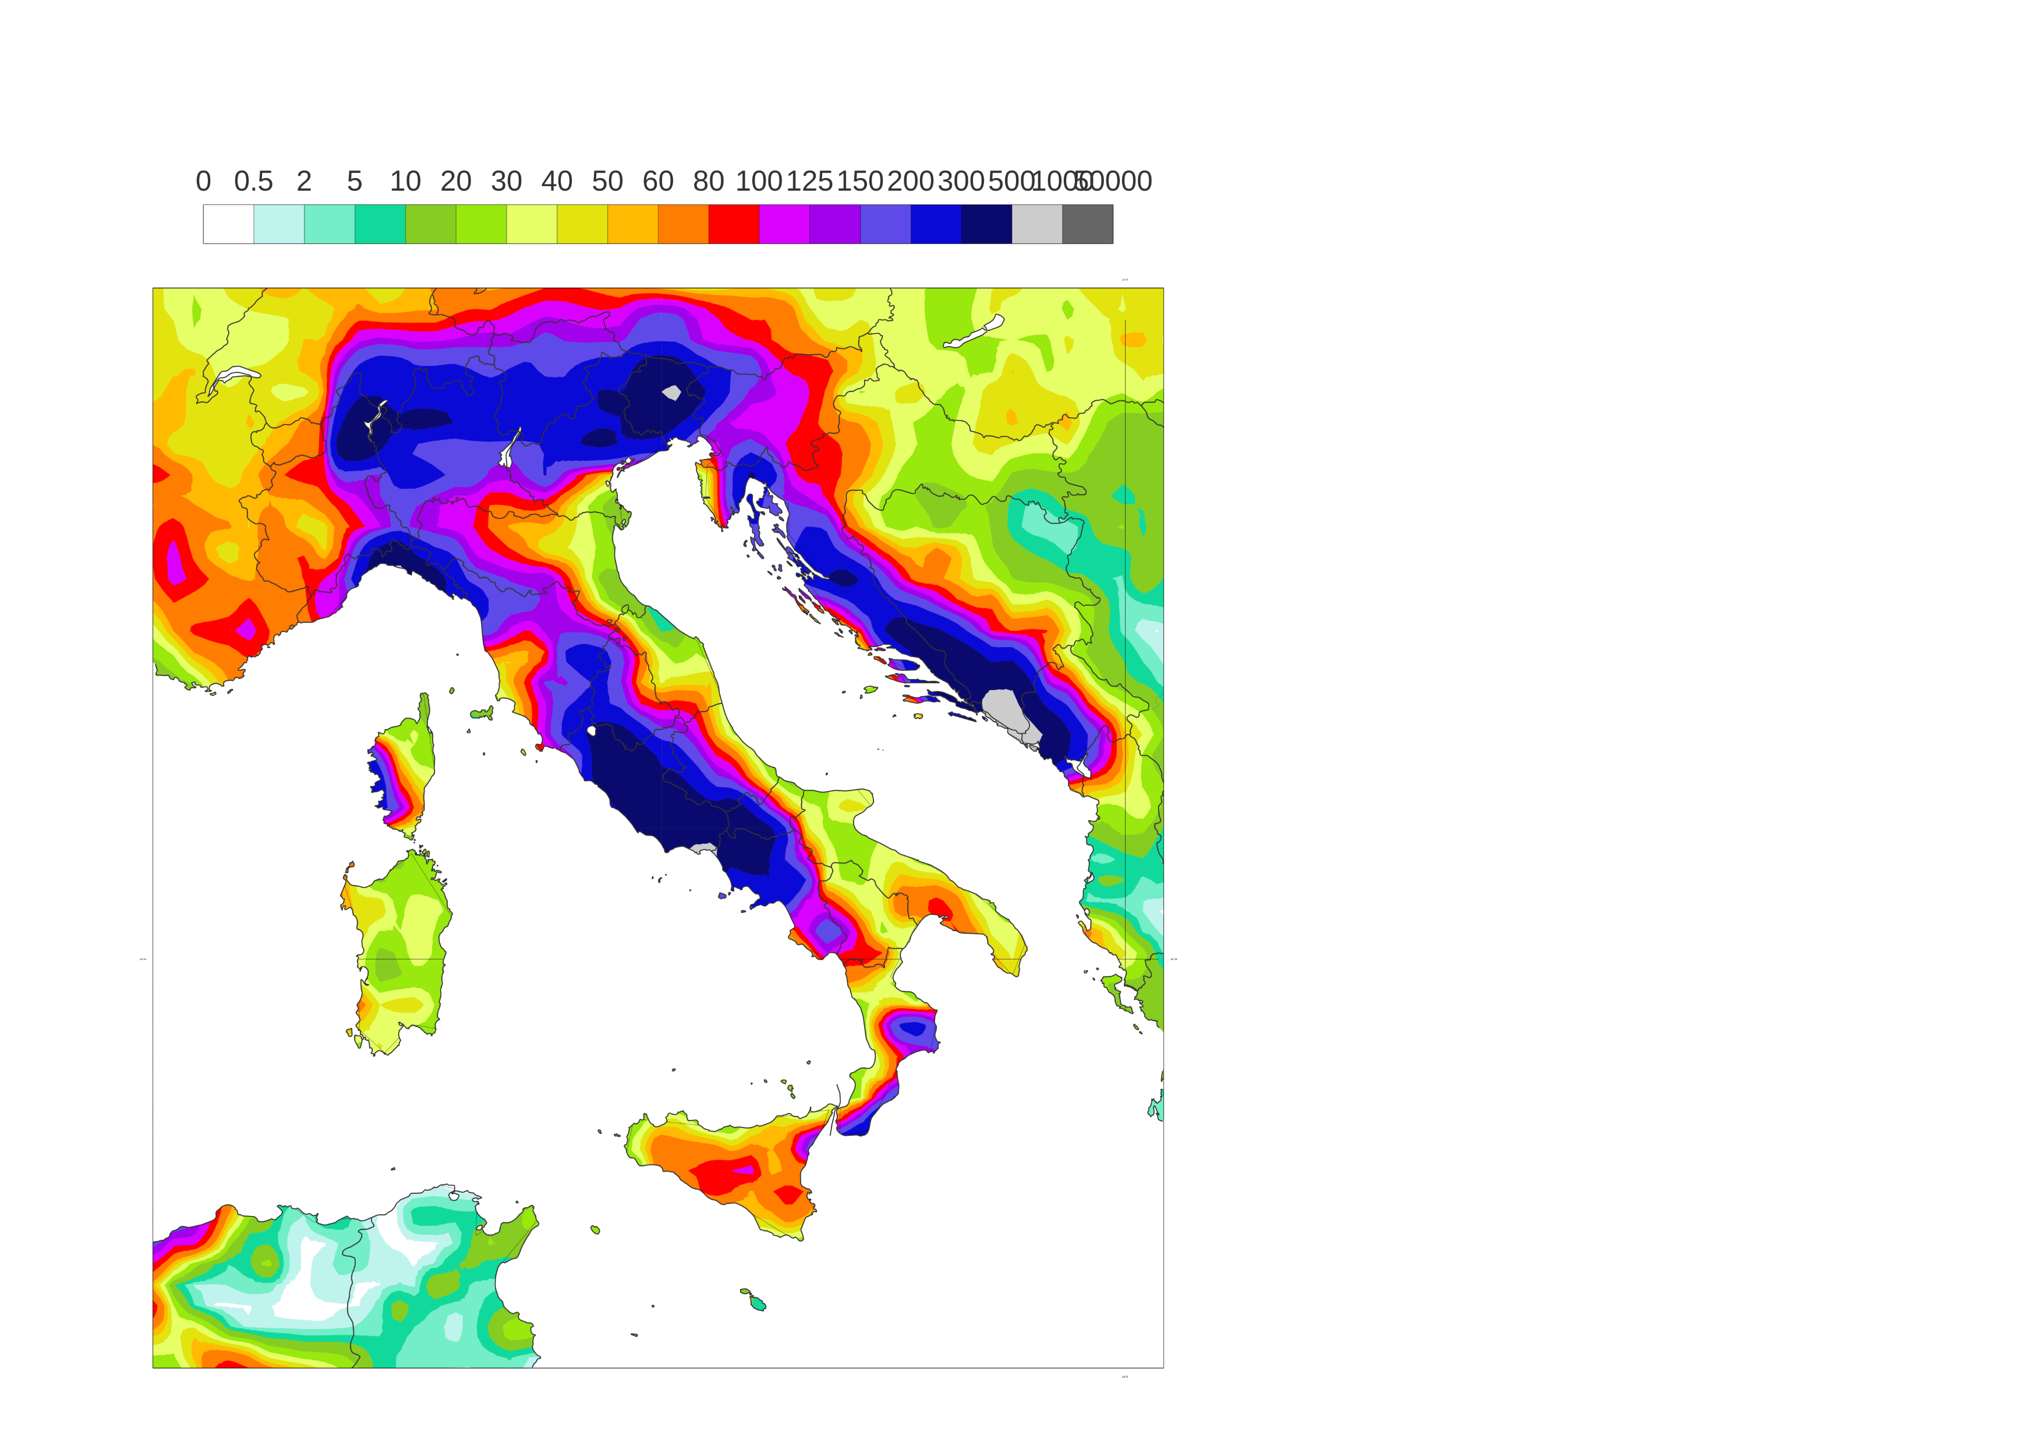
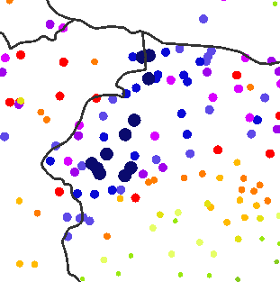
24-hourly total precipitation [mm/24h] for widespread flash floods in Italy (Storm Vaia)
Valued valid between 28th October 2018 at 00 UTC and 29th October 2018 at 00 UTC
Rain gauge observations
point scale
(b) ERA5 – EDA, Control Run
62 km
(c) ERA5
31 km
mm/24h
inf
1000
206.8
500
183.8
137.2
300
200
164.8
150
241.7
237.2
194.4
125
262.8
100
(d) ECMWF Reforecasts - 46r1, Day 1 Control Run, 18 km
(e) ERA5 – ecPoint
Point-scale on ERA grid
80
302.4
308
60
356.8
303
50
399
326.2
40
30
380
20
10
406
5
362
2
389
405
0.5

